Slide 1

UNIT-I
DR. AMOL DHUMANE

Slide 2
Introduction to machine learning
Enables computers to learn automatically from past data.
Machine learning uses various algorithms for building mathematical models and making predictions using historical data or information.
Currently, it is being used for various tasks such as image recognition, speech recognition, email filtering, Facebook auto-tagging, recommender system, and many more.

Slide 3
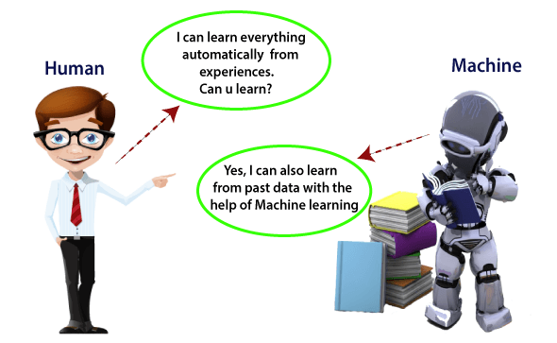

Slide 4
Introduction to machine learning…
Machine Learning is said as a subset of artificial intelligence that is mainly concerned with the development of algorithms which allow a computer to learn from the data and past experiences on their own.
The term machine learning was first introduced by Arthur Samuel in 1959.

Slide 5
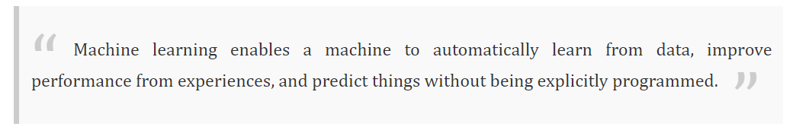
Introduction to machine learning…

Slide 6
Introduction to machine learning…
Machine learning brings computer science and statistics together for creating predictive models.
Machine learning constructs or uses the algorithms that learn from historical data. The more we will provide the information, the higher will be the performance.

Slide 7
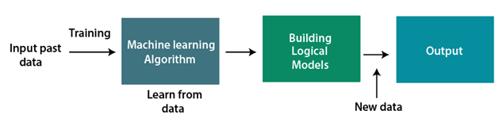
How machine learning works?

Slide 8
Features of Machine Learning
Machine learning uses data to detect various patterns in a given dataset.
It can learn from past data and improve automatically.
It is a data-driven technology.
Machine learning is much similar to data mining as it also deals with the huge amount of the data.

Slide 9
Need for Machine Learning
The need for machine learning is increasing day by day. The reason behind the need for machine learning is that it is capable of doing tasks that are too complex for a person to implement directly.
As a human, we have some limitations as we cannot access the huge amount of data manually, so for this, we need some computer systems and here comes the machine learning to make things easy for us.
Notes:
https://www.javatpoint.com/machine-learning

Slide 10
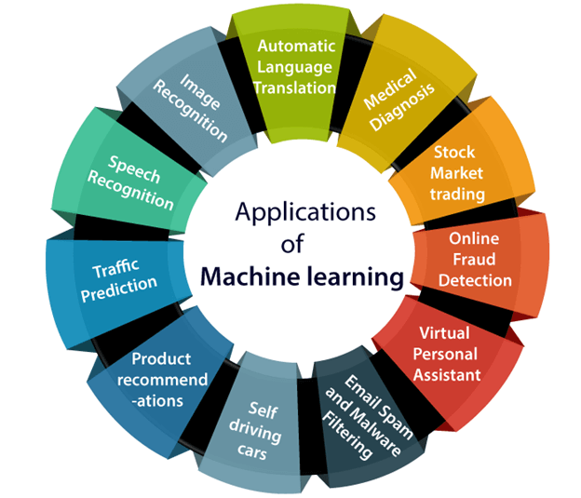

Slide 11
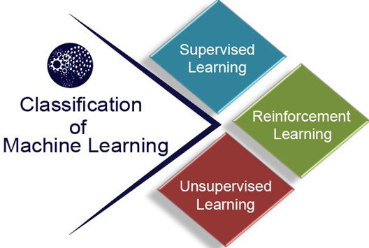

Slide 12
Machine Learning Task – performance measures
Task | Measures
Classification | Error
Regression | Error
Clustering | scatter/purity
Association | Support/Confidence
Reinforcement Learning | Cost/Reward

Slide 13
Supervised learning
Supervised learning, as the name indicates, has the presence of a supervisor as a teacher.
Basically supervised learning is when we teach or train the machine using data that is well labelled. Which means some data is already tagged with the correct answer.
After that, the machine is provided with a new set of examples(data) so that the supervised learning algorithm analyses the training data(set of training examples) and produces a correct outcome from labelled data.

Slide 14
Supervised learning
Supervised learning, as the name indicates, has the presence of a supervisor as a teacher.
Basically supervised learning is when we teach or train the machine using data that is well labelled. Which means some data is already tagged with the correct answer.
After that, the machine is provided with a new set of examples(data) so that the supervised learning algorithm analyses the training data(set of training examples) and produces a correct outcome from labelled data.

Slide 15
Supervised learning
Suppose we have a dataset of different types of shapes which includes square, rectangle, triangle, and Polygon. Now the first step is that we need to train the model for each shape.
If the given shape has four sides, and all the sides are equal, then it will be labelled as a Square.
If the given shape has three sides, then it will be labelled as a triangle.
If the given shape has six equal sides then it will be labelled as hexagon.
Now, after training, we test our model using the test set, and the task of the model is to identify the shape.

Slide 16
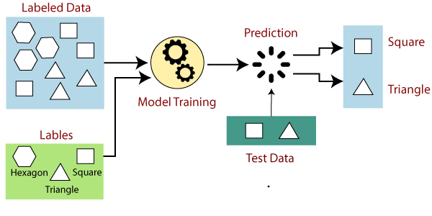
Supervised learning

Slide 17
Basic Steps involved in Supervised learning
Collect/Gather the labelled training data.
Split the training dataset into training dataset and test dataset.
Determine the suitable algorithm for the model, such as support vector machine, decision tree, etc.
Execute the algorithm on the training dataset.
Evaluate the accuracy of the model by providing the test set. If the model predicts the correct output, which means our model is accurate.

Slide 18
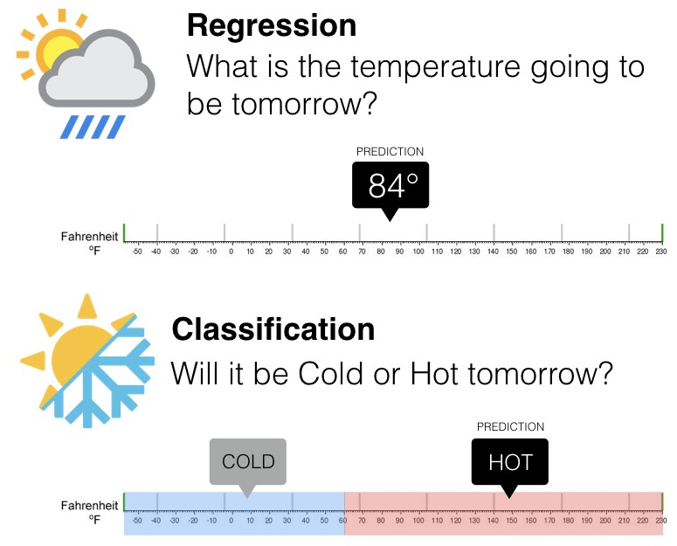
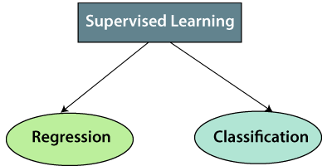
Types of supervised Machine learning Algorithms

Slide 19
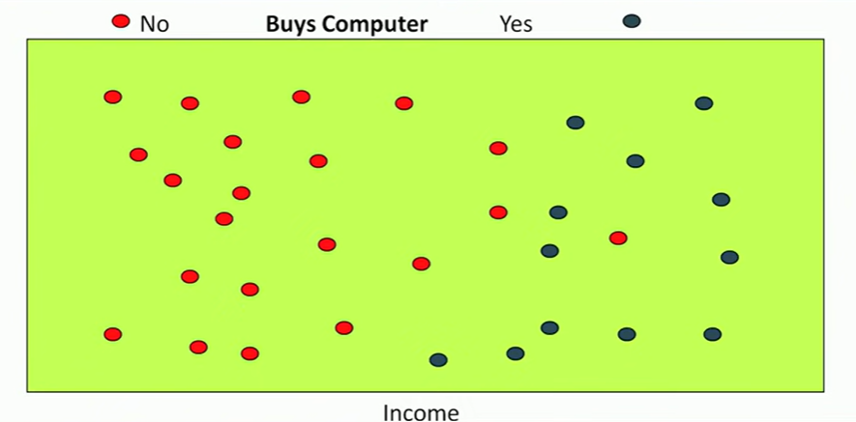

supervised Machine - Classification

Slide 20
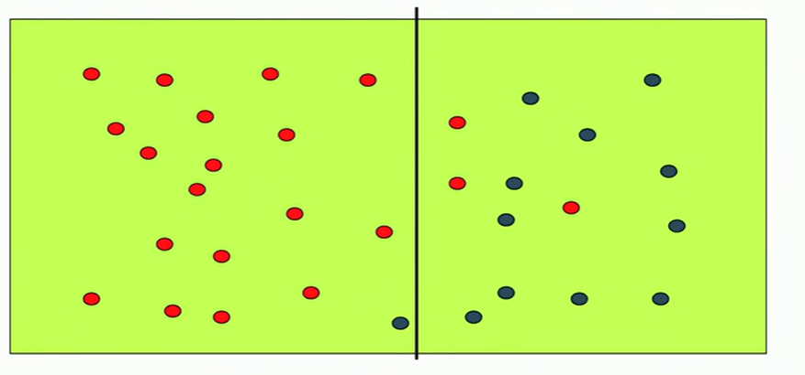
supervised Machine - Classification

Slide 21
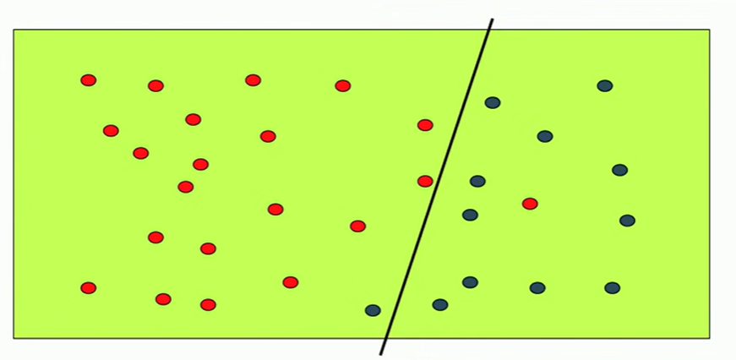
supervised Machine - Classification

Slide 22
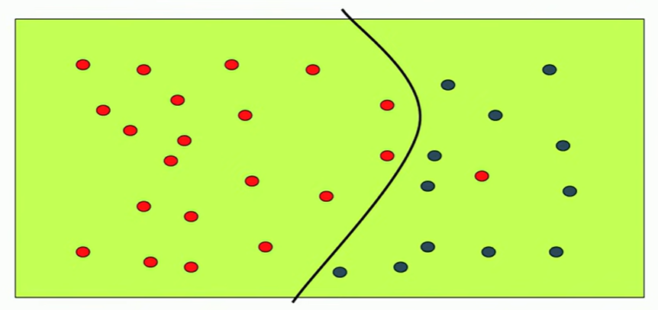
supervised Machine - Classification

Slide 23
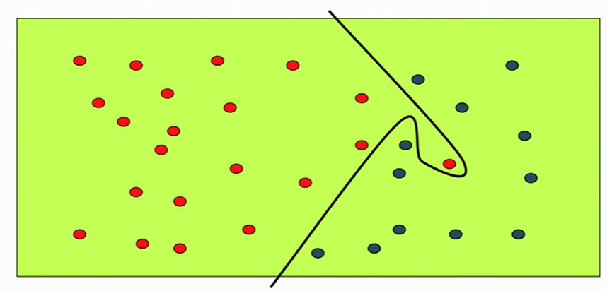
supervised Machine - Classification

Slide 24
Classification applications
Credit Card Fraud Detection
Sentiment Analysis (Opinion Mining)
Medical Diagnosis
Spam Mail Detection

Slide 25
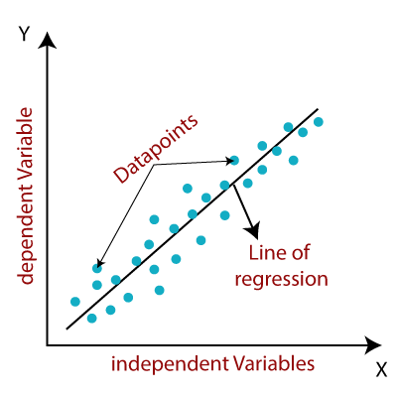
supervised Machine - regression

Slide 26
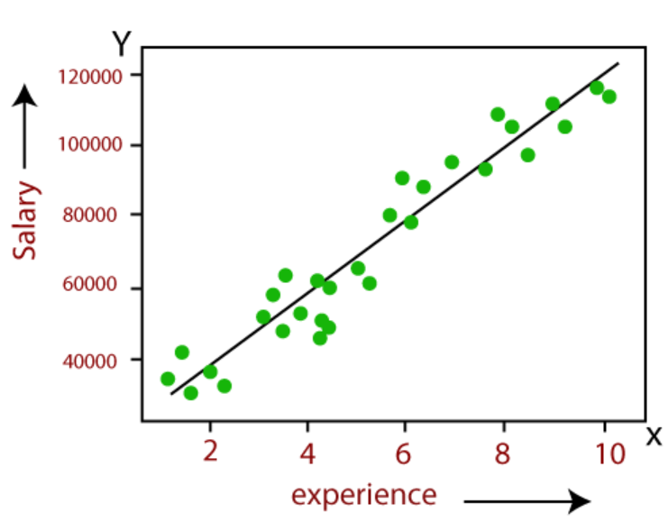
supervised Machine - regression

Slide 27
supervised Machine learning – regression - applications
Price Prediction
Time Series Prediction
Rainfall in certain region
Stock price prediction
Trend Analysis
Linear or Exponential

Slide 28
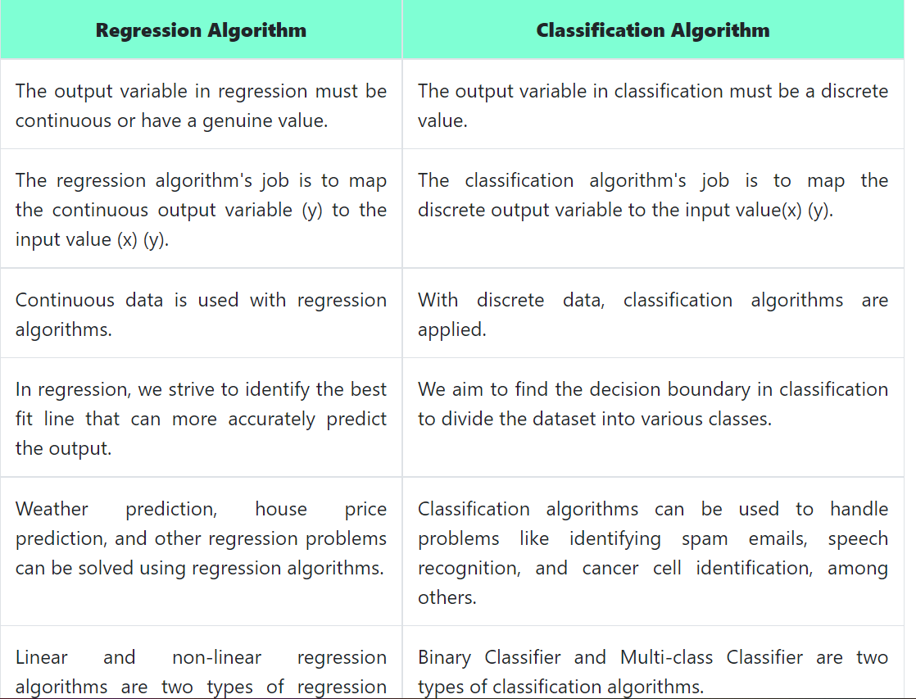
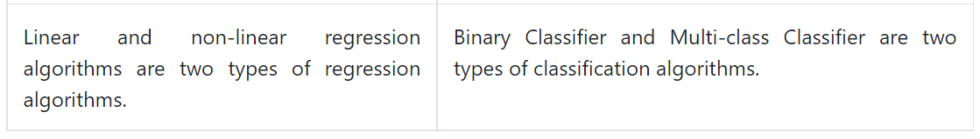

Slide 29
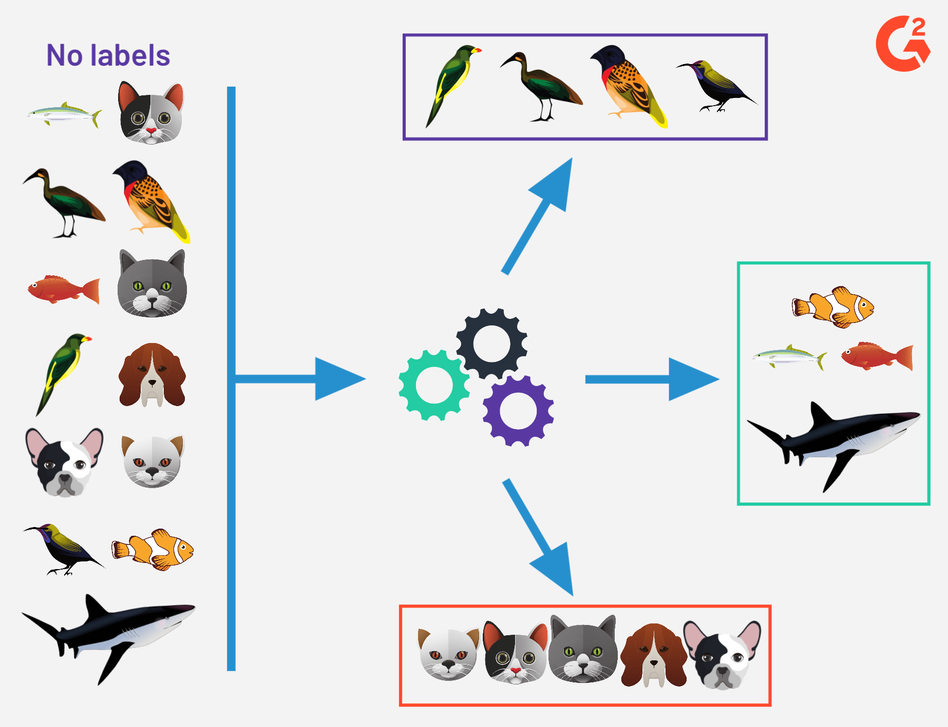
Unsupervised learning

Slide 30
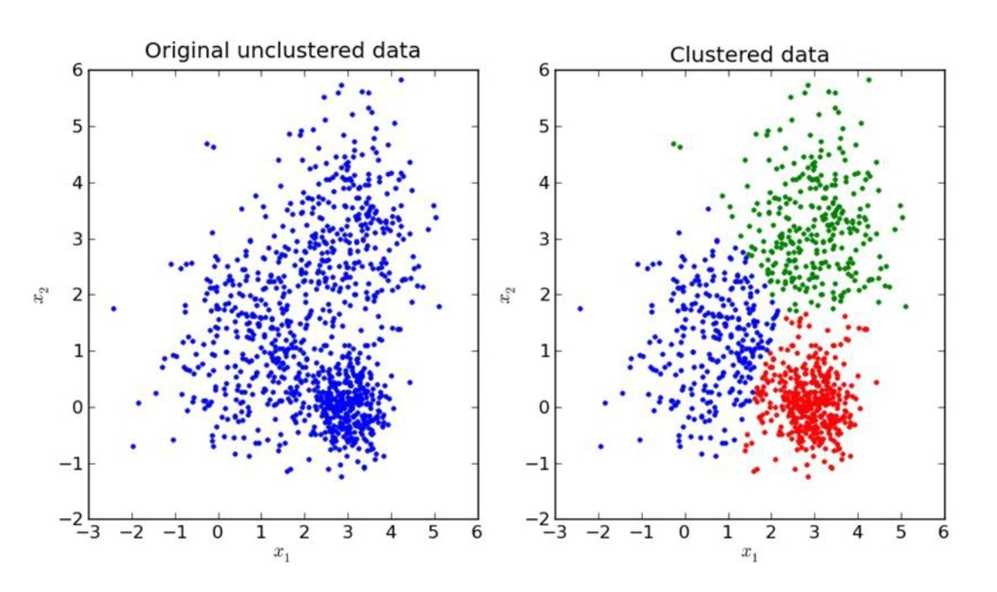
Unsupervised learning

Slide 31
Unsupervised learning

Slide 32
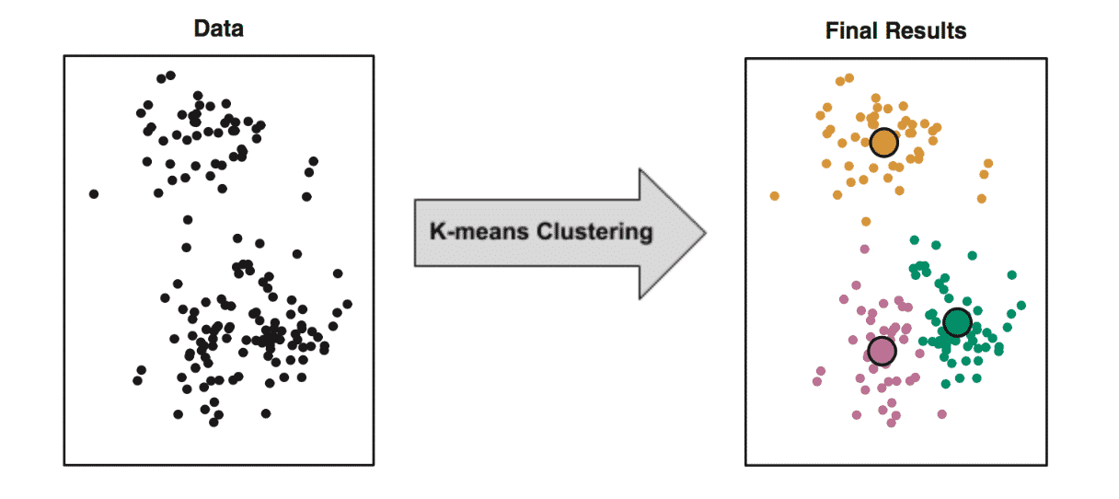
Unsupervised learning

Slide 33
Unsupervised learning - Applications
Collect/Gather the labelled training data.
Split the training dataset into training dataset and test dataset.
Determine the suitable algorithm for the model, such as support vector machine, decision tree, etc.
Execute the algorithm on the training dataset.
Evaluate the accuracy of the model by providing the test set. If the model predicts the correct output, which means our model is accurate.

Slide 34
